Slide 1


IS4S706 Project Management & Research Methodology
Research Methods Part One
David Kidner (J302)
david.kidner@southwales.ac.uk

Slide 2
Research Methods
Plenty of books out there on Research Methods
E.g. Sage link through FindIt
So, try to keep a focus; and don’t get sidetracked.
Are there RM books in your specific subject / topic area
Remember the filtering of results (from Sharon’s talk).
Just focus on chapters relevant to your project

Slide 3
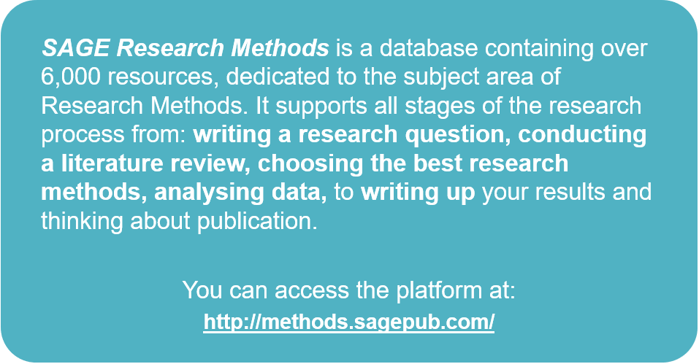
… Or through FindIT

Slide 4
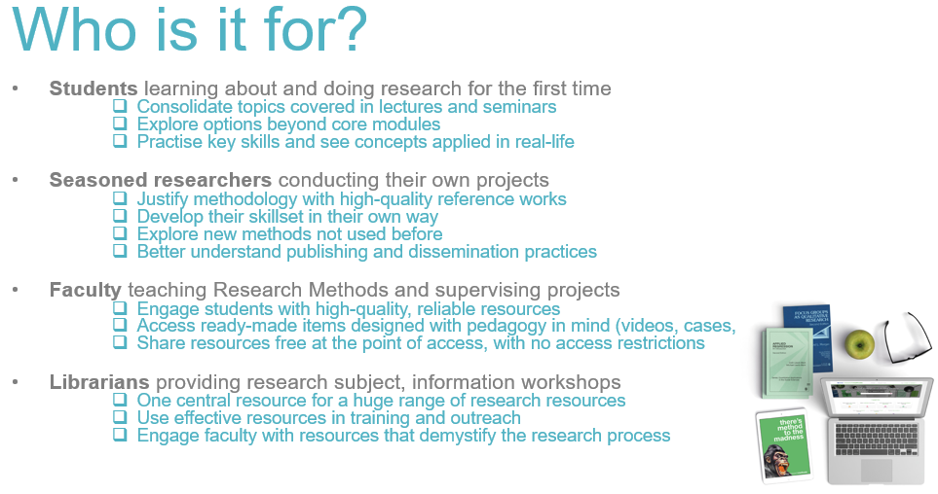

Slide 5

SAGE Research Methods Homepage
SAGE Research Methods content will also be available through USW FindIT, and search engines like Google.

Slide 6
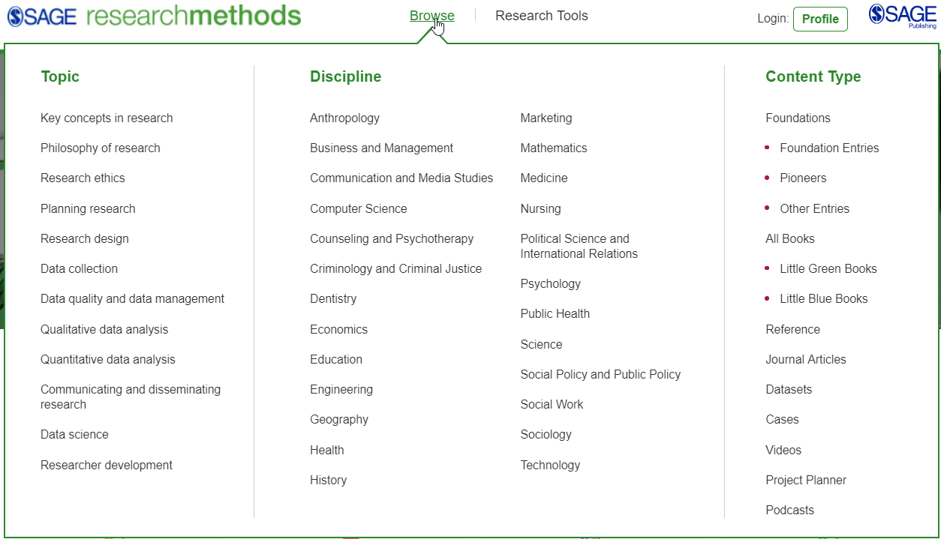
Browse Options
Click on any of the links to get to a list of results.
Use the Browse drop-down menu to browse by Topic, Discipline, or Content Type.

Slide 7
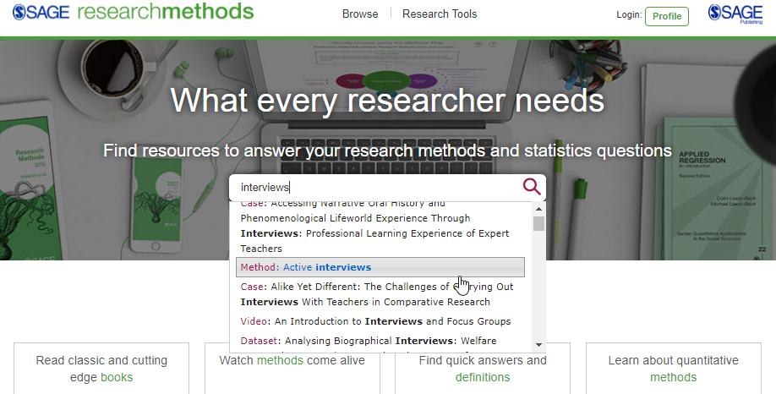
Quick Search
Use the quick search to look for key words and phrases; you can use Boolean Operators AND, OR and NOT.

Slide 8
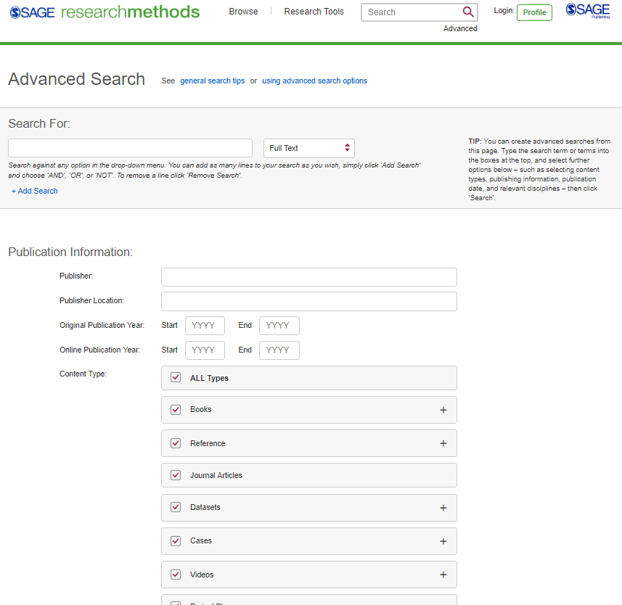
Advanced Search
Enter your search criteria, and add new rows to search multiple criteria
Access the Advanced search from any page on the platform
Search specifically for publishers, e.g. authors
Select which content types you want to search across
Select your publication date ranges
Explore more search options further down the page

Slide 9
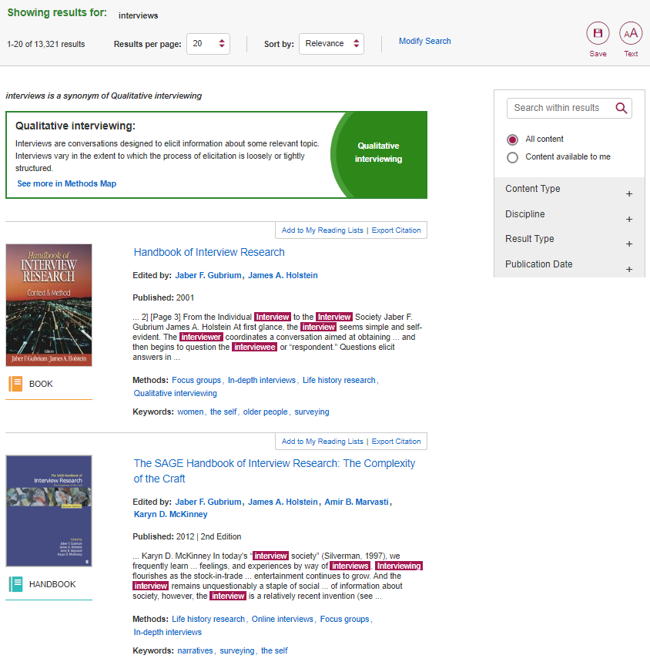

Viewing Your Results
The Refine By filter ensures that you only see resources that are available through your USW’s subscription.
Click the resource title to view the full text.
Resource is not available through USW’s subscription
Use the filters on the right-hand side of the search results page to refine your search by Content Type, Discipline and Publication Date.
… and as with FindIT – Save Your Searches / Manage Reading Lists etc.

Slide 10
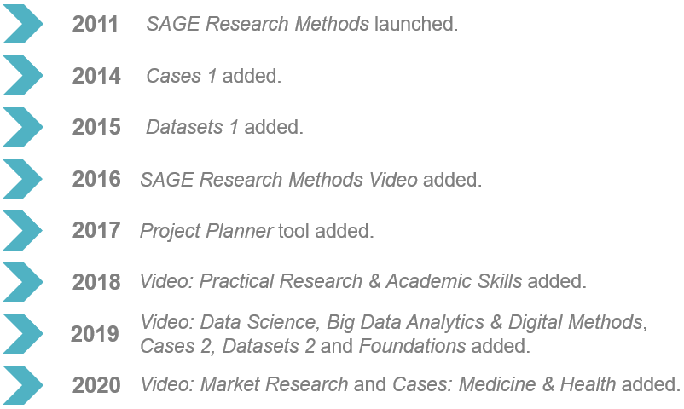
SAGE Research Methods

Slide 11

SAGE Research Methods: Tools
Access the Research Tools from anywhere in the platform at the top of the page, under Research Tools.

Slide 12
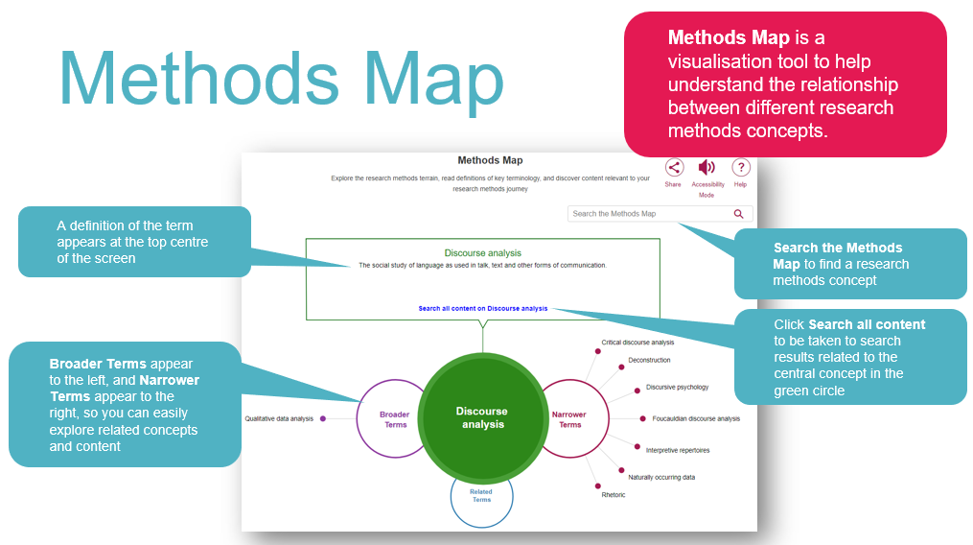

Slide 13
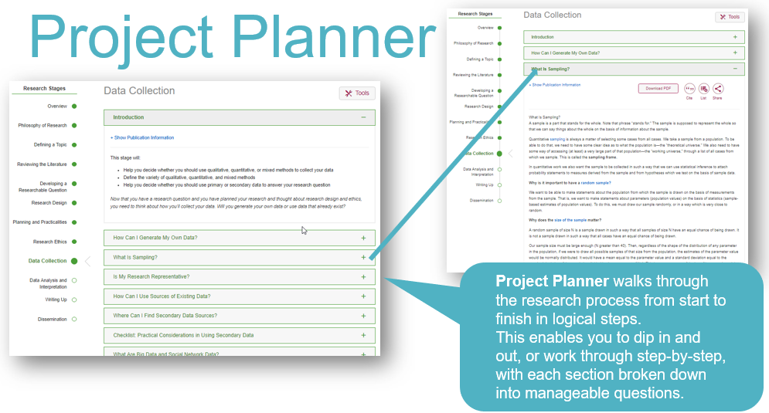

Slide 14
What is the Purpose of Research?
Discover the truth about something
Create, modify or justify a theory
Find a good or better way of doing or implementing something
Academic Research:
Must be Systematic, Clearly Written, Ethical - at a University Level of Acceptability, Trustworthy, Unbiased
Should be written with the expectation that it will be evaluated by a critical reader with an expert knowledge in the field
Ethical?

Slide 15
Types of Research Include…
Large scale surveys (of people, organisations, events, etc) analysed statistically
Small scale surveys with emphasis on “qualitative” detail
Case studies (to see how something works in detail)
Experiments (change something to see what happens)
Models can be set up, tested and used for …
Participant observation (observe as participant)
Action research (combine research and action)
Evaluation
… and may other possibilities …be imaginative!
Many projects combine several of these

Slide 16
Typical Research Project
Decide on Subject Area
Define topic areas and Research Question(s)
Develop Hypothesis
Set Boundaries AND Methodology AND Methods
Produce a Literature Review
Collect Data
Analysis (Statistical ?) / Evaluation
Conclusions
End ‘Report’ / ‘Academic Paper’ / Who is it for?

Slide 17
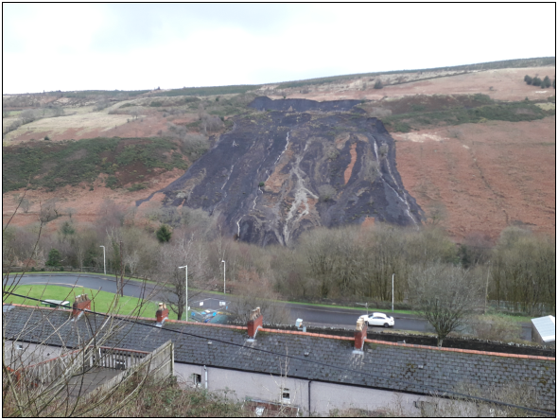
e.g. Tylorstown
Landslide Project
Decide on Subject Area
Landslide Modelling & Monitoring
Define topic areas and Research Question(s)
Can we accurately survey and computer model a landslide?
Can our Information System tell us what’s happening?
Can we measure the rate of change through time?
Can we predict (extrapolate) what’s going to happen next week/month/year?
Develop Hypothesis (“hunch that can be proven or disproven by valid and reliable data”)
Rhondda landslides “don't pose a risk to life and property“ (Mark Drakeford, First Minister, 25/02/2020, https://www.bbc.co.uk/news/uk-wales-51635124)

Slide 18
e.g. Tylorstown
Landslide Project
Set Boundaries/Methodology/Methods
Focus just on Tylorstown
Use Accurate Survey Techniques (e.g. GPS & Drones) capable of capturing millions of data points to +/- 2cms on a weekly basis for X weeks.
Produce computer models which generate information from this raw data.
Produce a Literature Review
What’s been done before on modelling & monitoring landslides?
What lessons have been learnt? How do we model the data? How did drones do?
Collect Data
If it ever stops raining. Risk Assessment. Health & Safety. Logistics.
Analysis (Statistical?) / Evaluation
3D Models, Visualisations, 2D Contour Maps, 3D Volumes, Temporal Analyses, Time-Series Animations, Volumetric Changes, …
Extrapolation & Prediction!
Conclusions
Rhondda landslides “don't pose a risk to life and property” TRUE or FALSE
End ‘Report’ / ‘Academic Paper’ / Who is it for?

Slide 19
Constructing a Hypothesis
“Brings clarity, specificity and focus to a research problem”
“Hunches/Assumptions that are tested through a study”
Definition:
“A hypothesis is written in such a way that it can be proven or disproven by valid and reliable data – it is in order to obtain these data that we perform our study”
Grinnell (1988:200) – Richard Jr Grinnell, Social Work Research and Evaluation.
In Practice:
Create a hypothesis
Gather evidence, and then
Analyse hypothesis against the evidence.
A Hypothesis is either true or not.
HW: Produce a Hypothesis associated with a Computing Research Project

Slide 20
Different Types of Hypotheses
1) ‘there is no significant difference in the proportion of male and female smokers in the study population’
this type of hypothesis construction stating no difference is called a null hypothesis
2) ‘A greater proportion of females than males are smokers in the study population’
the hypothesis indicates that there will be a difference but does not present the magnitude is called a hypothesis of difference
3) ‘A total of 60% of females and 30% of males in the study population are smokers’
where through previous knowledge an actual quantification of the difference is proposed, this is called a hypothesis of point difference
4) ‘There are twice as many female smokers to male smokers in the study population’
Stipulates the extent of the relationship between the two variables is called a hypothesis of association.

Slide 21
How to be Confident your Research matched the Expectations
Ensure that you clearly identify the expected path, the reasons to follow this path and use appropriate tools and methods to guide you along this path.
As a ‘novice’ how would you have this confidence?

Slide 22
What is a Research Methodology & Research Method?
Research Methodology:
like a set of rules and procedures to guide you through a project process.
Two main types of research:
Qualitative & Quantitative
Research Method:
the tools (techniques) for collecting data

Slide 23
Quantitive & Qualitative
Quantitative
as the name suggests, is concerned with trying to quantify things; it asks questions such as ‘how long’, ‘how many’ or ‘the degree to which’.
Quantitative methods look to quantify data and generalise results from a sample of the population of interest. They may look to measure the incidence of various views and opinions in a chosen sample for example or aggregate results.
MacDonald & Headlam "Research Methods Handbook", CLES, ISBN: 1870053656

Slide 24
Quantitive & Qualitative
Qualitative
concerned with the quality of information, qualitative methods attempt to gain an understanding of the underlying reasons and motivations for actions and establish how people interpret their experiences and the world around them. Qualitative methods provide insights into the setting of a problem, generating ideas and/or hypotheses.
MacDonald & Headlam "Research Methods Handbook", CLES, ISBN: 1870053656

Slide 25
Quantitive & Qualitative
Quantitive vs. Qualitative
The lesser of two evils:
Either Count Things OR Talk to People!
Qualitative Research Data may often be converted into numbers (Quantified)
MacDonald & Headlam "Research Methods Handbook", CLES, ISBN: 1870053656

Slide 26
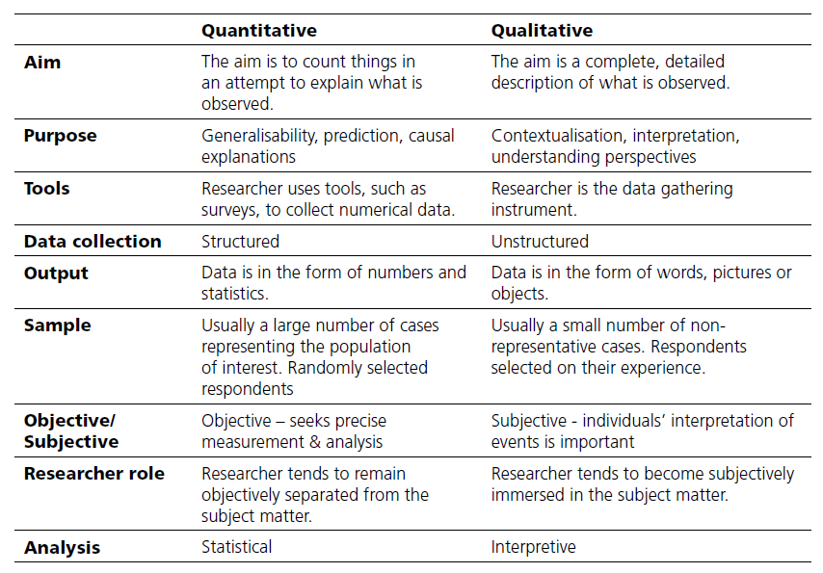
Quantitive & Qualitative
e.g. Relate to
“Landslide Problem”
What do you think
of USW as a centre of
Post-grad education?
MacDonald & Headlam "Research Methods Handbook", CLES, ISBN: 1870053656

Slide 27
Tutorial / Homework
Look at the exercise questions …
Bring along your “solution” or proposal next time.
i.e. e-mail through to david.kidner@southwales.ac.uk some ideas before 26th March.
The aim is to make sure you start thinking about your proposal – and identify the resources available to you.
And also identify what’s not possible or feasible (now rather than later).

